Slide 1

CS1951 L
Blockchains & Cryptocurrencies
Spring 2024
Lecture 24
Season Finale
Maurice Herlihy
Brown University

Slide 2
Sponsored Content

Slide 3
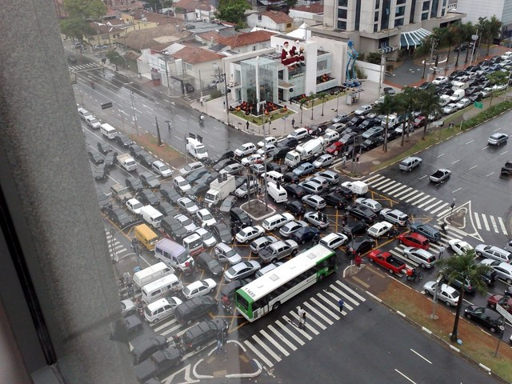
CSCI 1760: Multiprocessor Synchronization
or
“Bad Synchronization Ruins Everything”
Bad synchronization ruins everything
Prof. Maurice Herlihy
TTh 1:00 2:20

Slide 4

Interested in TAing for this course?
Will be taught again in Spring 2025
Opportunity to really learn material
Develop new projects, improve old projects
Yes, you are qualified

Slide 5
Interested in blockchain research?
Contact me in the fall …
We will have various projects TBD
You can contribute
Develop your MVP!

Slide 6
Regularly Scheduled Lecture

Slide 7
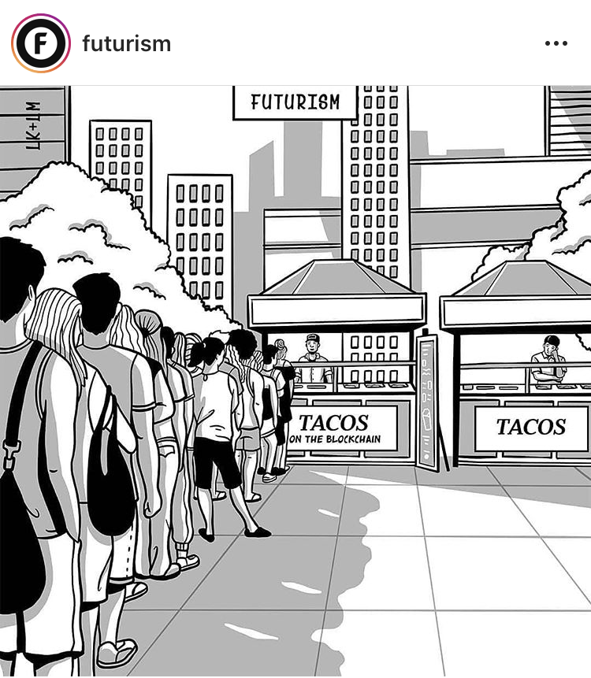

Slide 8
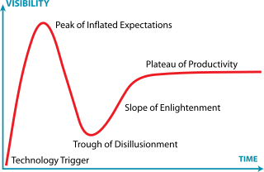
BTC at $68,990.90
Crypto Winter?
Our mission here

Slide 9


Some Say …

Slide 10
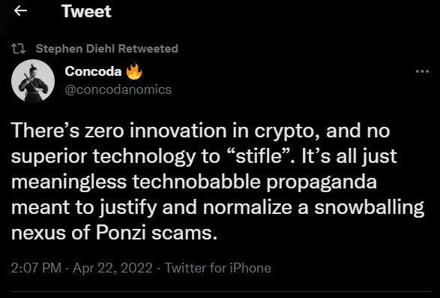
Others Say …
If Wolf of Wall Street were about crypto:
https://www.youtube.com/watch?v=KHEZCXfyxjU&ab_channel=JomaTech

Slide 11
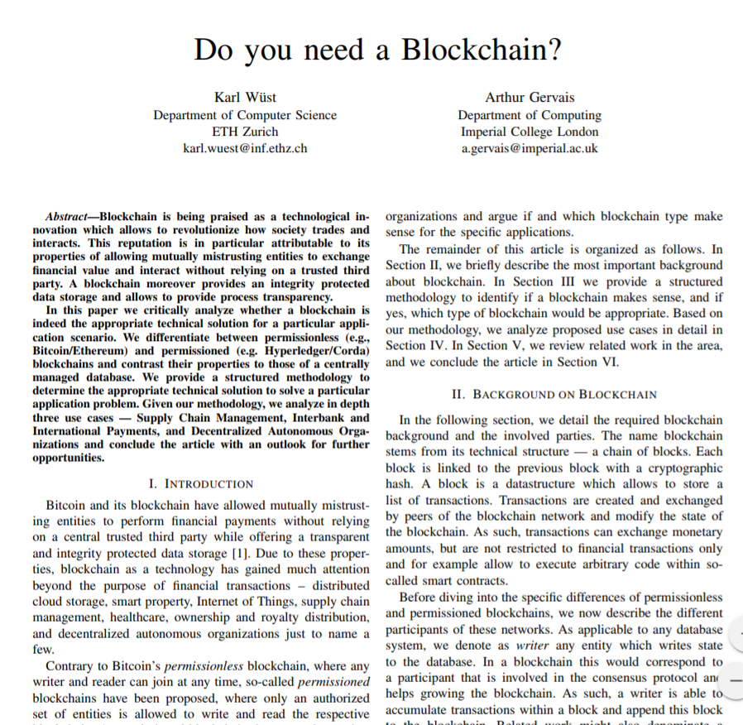

Slide 12
Do You Need a Blockchain?
Do you need to store state?
yes
no
Nope, Blockchains are databases

Slide 13
Do You Need a Blockchain?
Are there multiple writers?
…
yes
no
Nope, just use a regular database

Slide 14
Do You Need a Blockchain?
Trusted Third Party?
…
no
yes
Nope, let TTP ensure security

Slide 15
Do You Need a Blockchain?
Are all writers known?
…
no
Permissionless
Blockchain
yes

Slide 16
Do You Need a Blockchain?
…
Are all writers trusted?
no
yes
Nope, just use a regular database

Slide 17
Do You Need a Blockchain?
Is public verifiability required?
Public Permissioned Blockchain
…
no
yes
Private Permissioned Blockchain

Slide 18

State: custody, temperature, location …
Multiple writers: farmer, truck, warehouse, …
No trusted 3rd party?
Writers known
Private Permissioned Blockchain
Writers not trusted

Slide 19

State: accounts, debts
Multiple writers: the banks
Replace banks as trusted 3rd party?
Writers known
Private Permissioned Blockchain
Writers not trusted

Slide 20
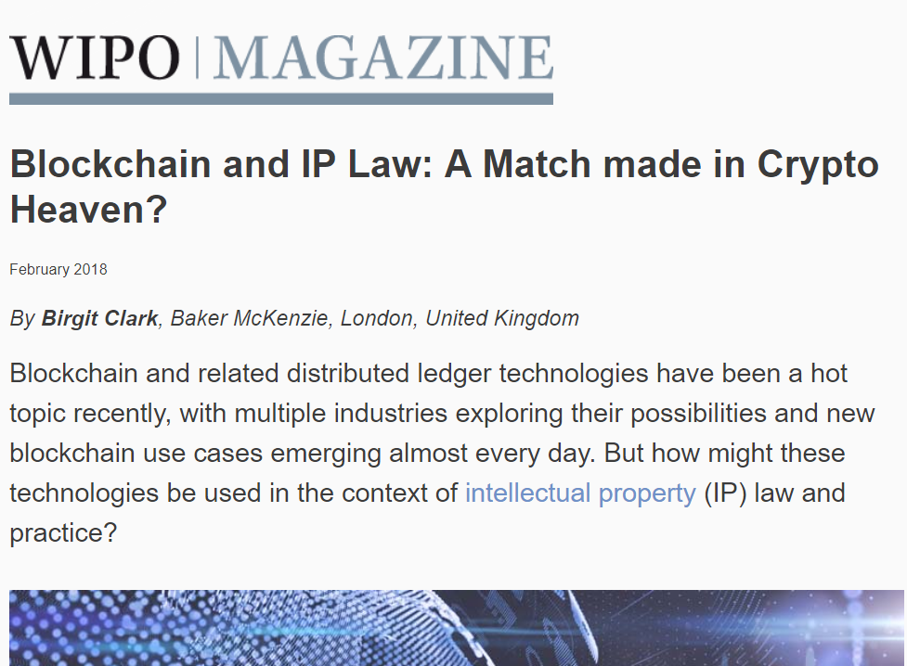
State: owners, patents, music, video
Multiple writers: inventors, artists
Replace patent , copyright office as trusted 3rd party?
Writers unknown
Unpermissioned Blockchain
Writers not trusted

Slide 21
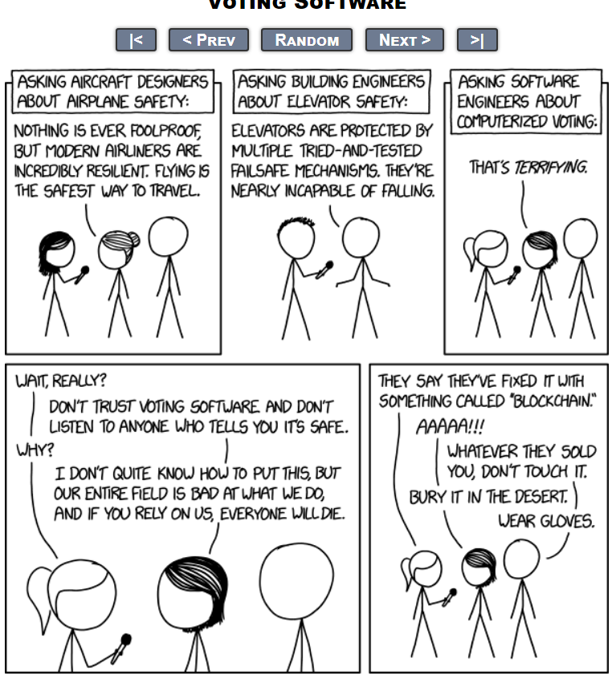
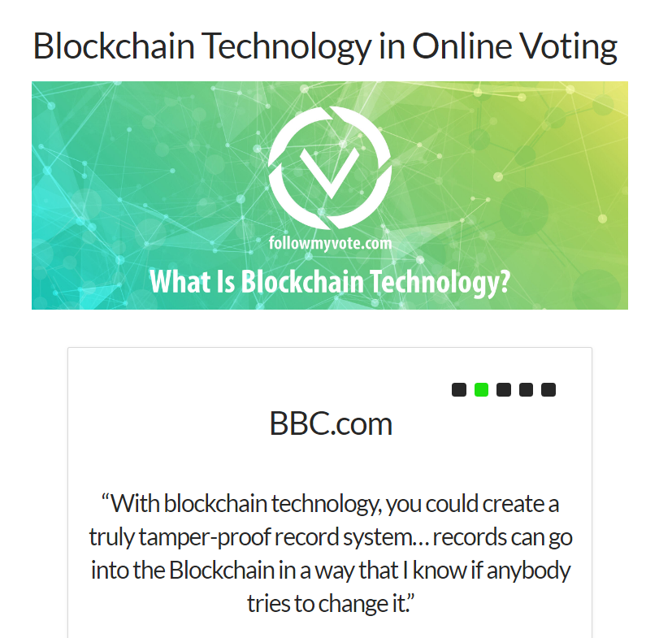

Slide 22
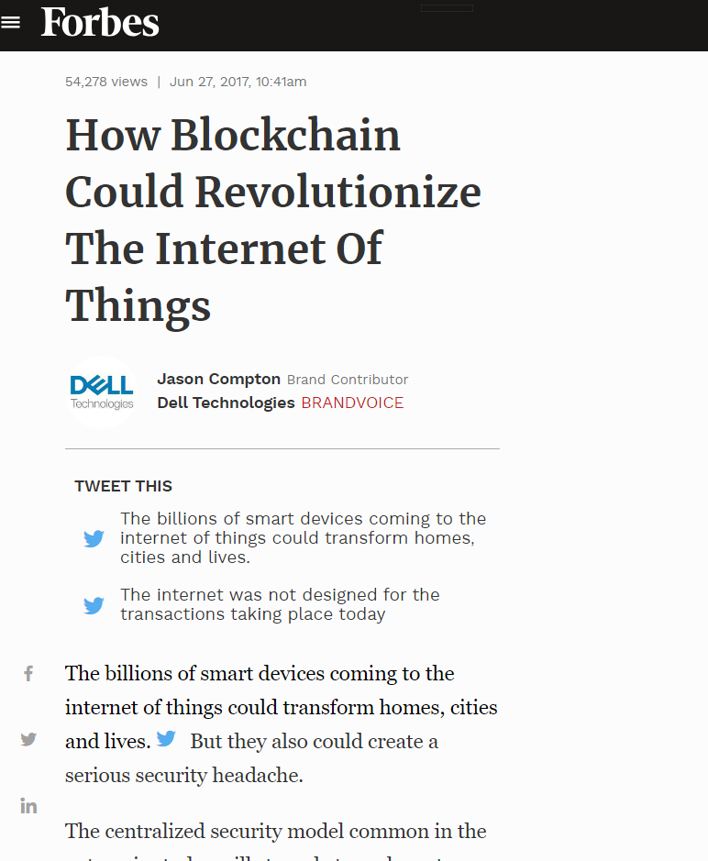
State: your refrigerator buys milk when you run out
Multiple writers: sensors, devices
No trusted 3rd party
Writers known
Private
Permissioned Blockchain
Writers not trusted

Slide 23

Data: who owns which properties
Multiple writers: buyers, sellers, gov’t agencies
Replace government archive as trusted 3rd party
Writers known
Public
Permissioned Blockchain
Writers not trusted

Slide 24
We shouldn’t care (much) what happens to Bitcoin, Solana, Dogecoin, etc.
Notes:
But, now this keynote is about to change key. I am now going to be serious. This talk is not about Bitcoin, which I don’t think is nearly as interesting, at least in a scientific sense, as many people think. It’s entertaining, but not necessarily serious.

Slide 25
We should care about the underlying Blockchain Technology
Notes:
But, now this keynote is about to change key. I am now going to be serious. This talk is not about Bitcoin, which I don’t think is nearly as interesting, at least in a scientific sense, as many people think. It’s entertaining, but not necessarily serious.

Slide 26

timing
Hello World!
crashes
omission
Byzantine
Now solve consensus, Paxos …
Classical Adversary

Slide 27

Side-channels
Привет мир!
rootkits
你好，世界！
Eclipse, 51%, re-entrancy …
!سلام دنیا
¡Hola Mundo!
zero-day
Now solve elections,
finance …
Modern Adversary

Slide 28
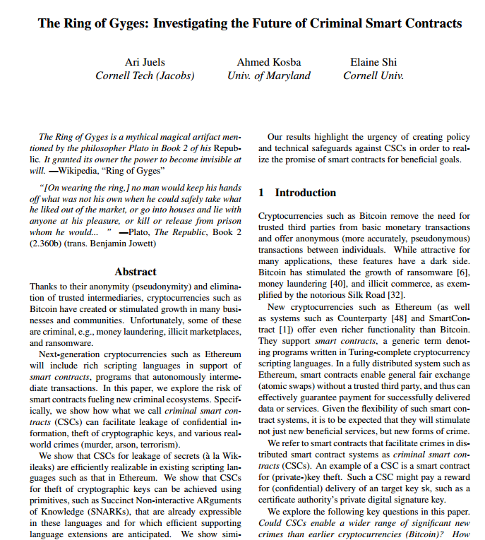
Smart contracts for crime:
Key theft
arson
vandalism
assassination
category theory
Automatic payoff via smart contract
possible to verify “real-world” events
How to intervene?

Slide 29
Abstraction

Slide 30
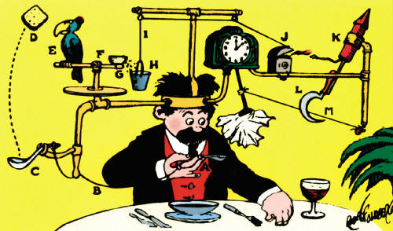
Blockchain World Today
No specifications ….
Only reference implementations
Vulnerability is not a bug!
Exploiting vulnerability not a hack!

Slide 31
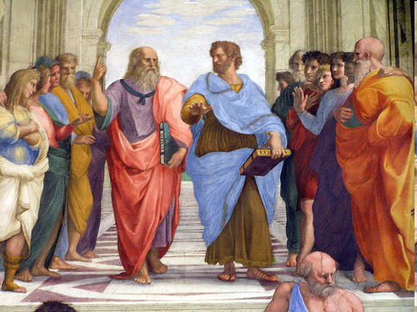
Software should separate formal specification from implementation!
What does that even mean?
World
Academic researchers
1980s
Notes:
There is a long history of people who study things admonishing people who do things to separate the formal spec of what is supposed to be done from the concrete details of how it is done, the better to provide that it’s done correctly. At first, this was considered radical, and maybe borderline offensiive.

Slide 32
Software should separate formal specification from implementation!
Thanks, I think we got it already …
1990s
1990s
Notes:
After a while, the software people got the message, and became pretty good at designing languages and logics that did exactly that. It’s obviously far from perfect, but the message want from outrageous to anodyne pretty quickly.

Slide 33
Software should separate formal specification from implementation!
Now you’re just ranting
1990s
1990s
2000s
Notes:
There are still distinguished researchers who go around complaining about the lack of separation, but no one really pays attention because everyone accepts the idea, even if the realization is often imperfect.

Slide 34
Blockchains should separate formal specification from implementation!
What does that even mean?
1990s
1990s
2000s
Today
Notes:
But here we are again. Blockchain-based applications are typically specified by a reference implementation, not a formal spec.

Slide 35
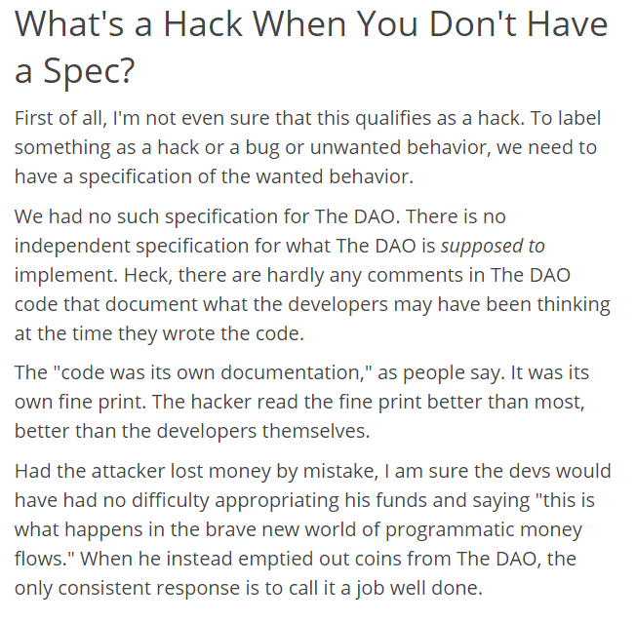
Emin Gun Sirer: you can’t “hack” something with no specification

Slide 36
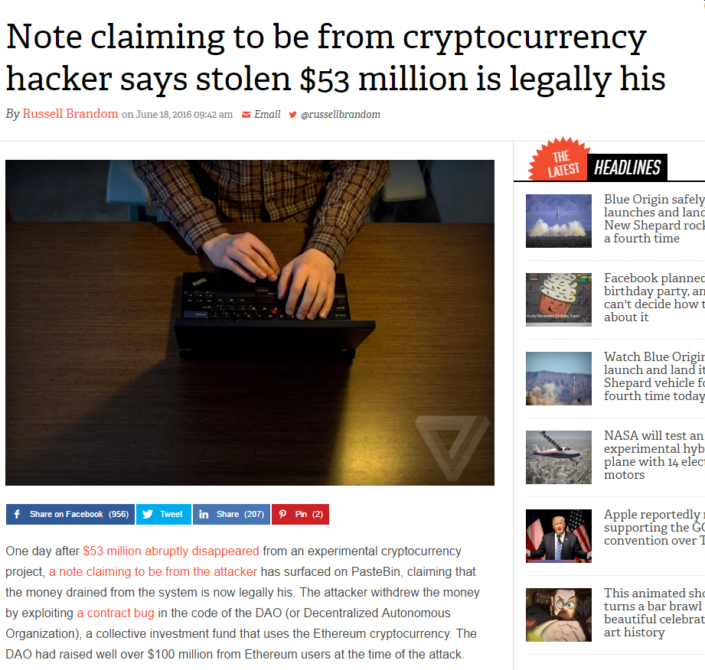
Never let anyone tell you formal methods don’t matter in the real world!

Slide 37
Reentrancy Attacks: An exotic hazard introduced by a radically new style of programming?

Slide 38
Reentrancy Attacks: An exotic hazard introduced by a radically new style of programming?
No.

Slide 39
Monitors (in Java)
public class Queue<T> {
int head = 0, tail = 0;
T[QSIZE] items;
public synchronized T deq() {
while (tail – head == 0)
wait();
T result = items[head % QSIZE]; head++;
notifyAll();
return result;
}
…
}}
39
Notes:
39
Synchronized methods use a monitor lock also.

Slide 40
Monitors
public class Queue<T> {
int head = 0, tail = 0;
T[QSIZE] items;
public synchronized T deq() {
while (tail – head == 0)
wait();
T result = items[head % QSIZE]; head++;
notifyAll();
return result;
}
…
}}
Each object has an implicit lock
40
Notes:
40
Synchronized methods use a monitor lock also.

Slide 41
Monitors
public class Queue<T> {
int head = 0, tail = 0;
T[QSIZE] items;
public synchronized T deq() {
while (tail – head == 0)
wait();
T result = items[head % QSIZE]; head++;
notifyAll();
return result;
}
…
}}
automatically acquire and release lock
41
Notes:
41
Synchronized methods use a monitor lock also.

Slide 42
Monitors
public class Queue<T> {
int head = 0, tail = 0;
T[QSIZE] items;
public synchronized T deq() {
while (tail – head == 0)
wait();
T result = items[head % QSIZE]; head++;
this.notifyAll();
return result;
}
…
}}
Release Lock, sleep, wake up
Reacquire lock
42
Notes:
42
Synchronized methods use a monitor lock also.

Slide 43
Monitor Invariants
public class Queue<T> {
int head = 0, tail = 0;
T[QSIZE] items;
public synchronized T deq() {
while (tail – head == 0)
wait();
T result = items[head % QSIZE]; head++;
notifyAll();
return result;
}
…
}}
Property that must hold while unlocked
OK to violate invariant while locked
Must restore invariant before releasing lock

Slide 44
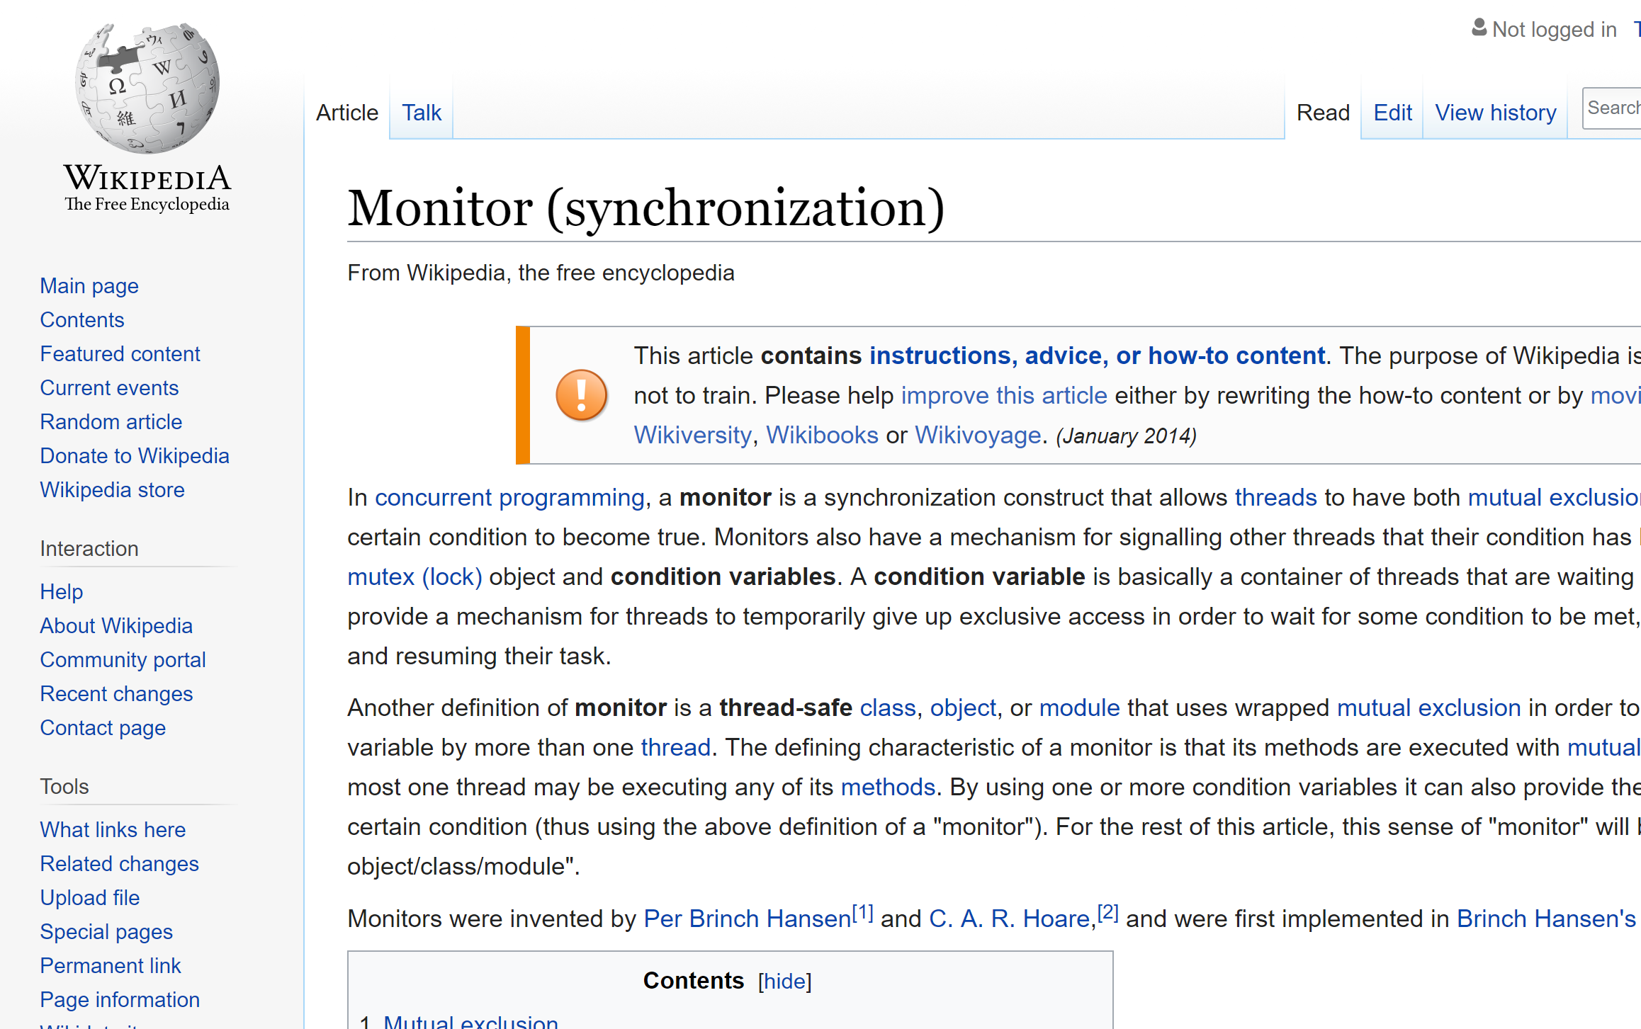
Reentrancy attack is just classical “monitor invariant” pitfall
Calling another contract =
releasing monitor lock
Must restore invariants before a call

Slide 45
“Miner Extractable Value” (MEV) or Accountability

Slide 46
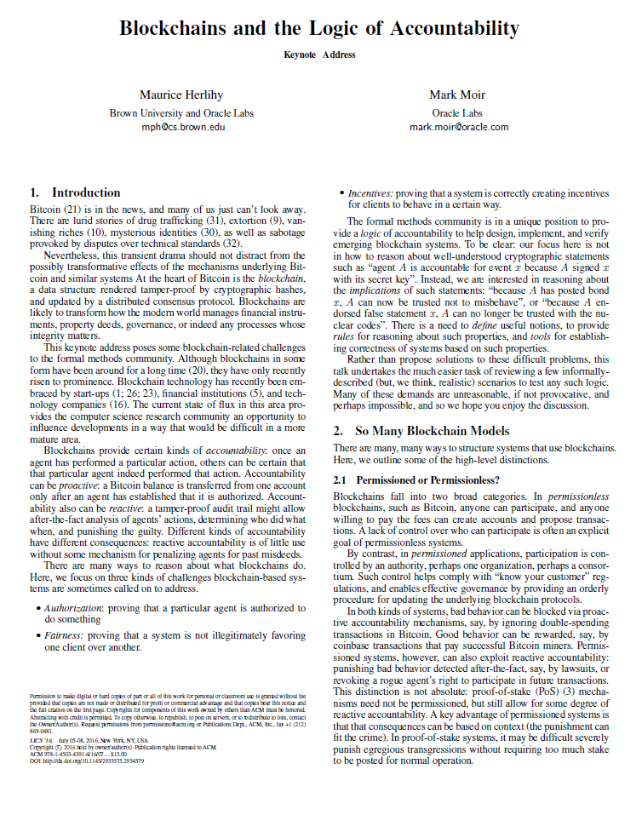
Accountability

Slide 47
Principle #1
Each non-deterministic choice …
… presents an opportunity to manipulate outcomes
As much as possible …
… non-deterministic choices should be made deterministic
Need mechanisms for …
Detecting violations and holding culprits accountable.

Slide 48
Principle #2
Non-deterministic choices that cannot be avoided …
should be disclosed in an auditable way …
ensuring that they cannot be altered later…
and that unusual statistical patterns can be detected

Slide 49
Principle #3
As much as possible …
… keep accountability mechanisms off critical paths.

Slide 50
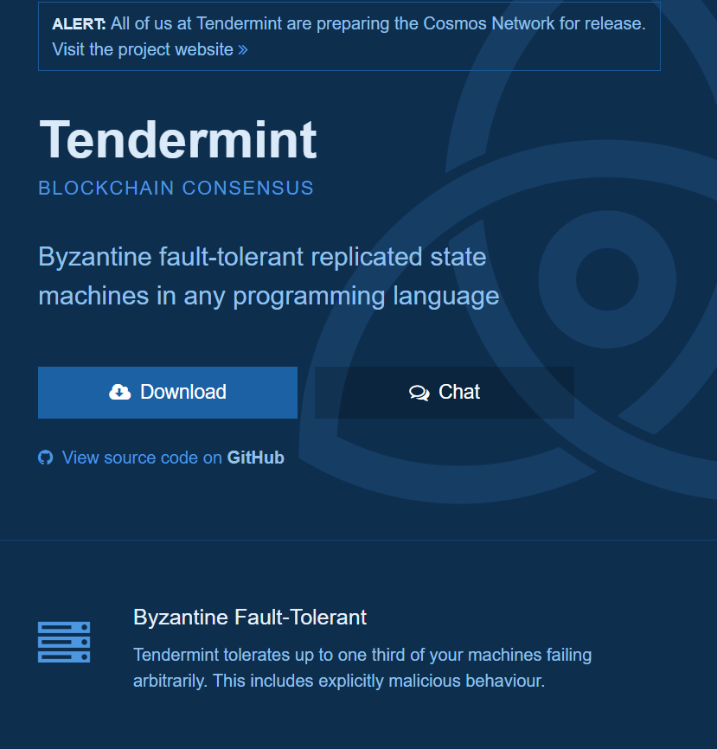
Permissioned blockchain
Currency = tokens purchased out-of-band

Slide 51
Validators
Uses Practical Byzantine Fault-Tolerance (PBFT)
to vote on next block
Proof of Stake: post bond, lose it if caught
Keep uncommited txns in mempool
51

Slide 52
Validators
On new txn from client:
Validate txn against committed blocks & mempool
Add to mempool
52

Slide 53
Validators
On new txn from peer:
Validate txn against committed blocks & mempool
Add to mempool
Preserve order
53

Slide 54
Validators
On newly committed block
Remove block txns from mempool
Revalidate mempool txns
Broadcast to peers
54

Slide 55
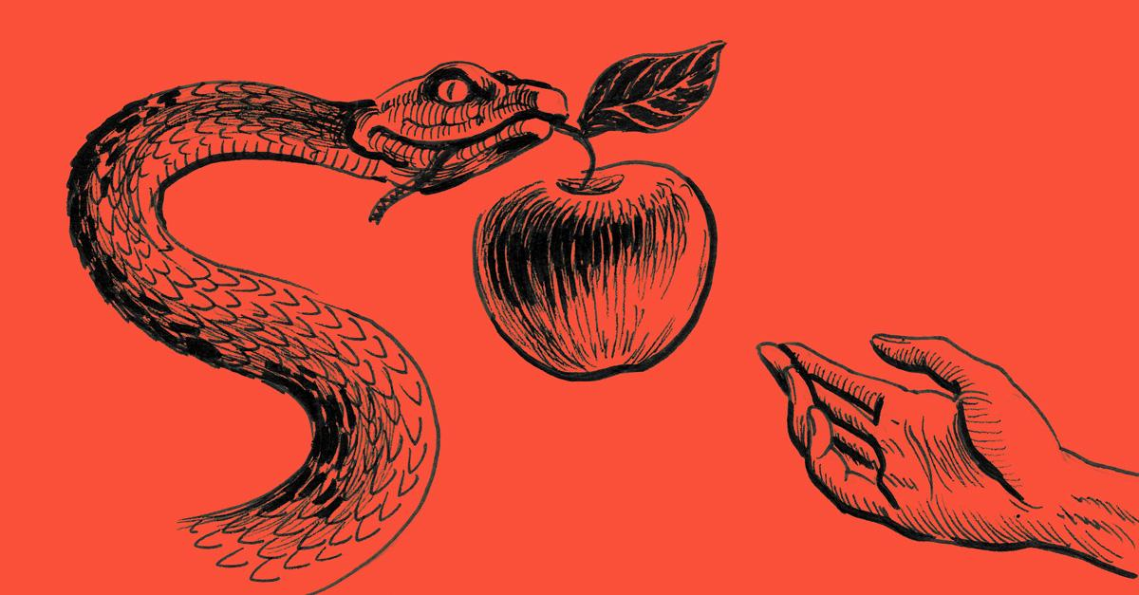
Deadly Sin #1
Censorship
Validator pretends she never got txn …
Either from client or peer
55

Slide 56
Deadly Sin #2
Order Manipulation
Reorder txns in mempool
Undetectable because mempool private
56

Slide 57
Deadly Sin #3
Transaction injection
Create another txn and order it first
“front-running” stock purchase
57

Slide 58

Transaction Ingress
On txn from client:
Return receipt …
Helps detect later censorship, reordering.
58

Slide 59
Legitimate Censorship
On txn from known deplorable:
Don’t simply discard …
Make rejection public …
By committing invalidation to blockchain
59

Slide 60
Transaction Propagation
When txn accepted from client or peer
Send to peers …
In same order to each peer …
In same order received from peer …
60

Slide 61
Summary
Accountability easier for permissioned ledgers
Identities, lawsuits, shaming ….
Non-determinism is evil
Need better foundations to progress …
61

Slide 62
Governance

Slide 63

Stability of txn validity rules
What makes a transaction valid?
When miners say so!
Canonicalism: all and only what Satoshi revealed?
Nope. What about upgrades?
… and bug fixes?

Slide 64
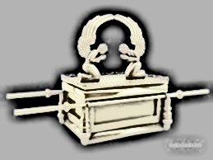
De facto governance by …
“Core Bitcoin Devs”
Commit access to bitcoind
Supported by the Bitcoin Fondation
Controversy wrt block sizes, etc.

Slide 65
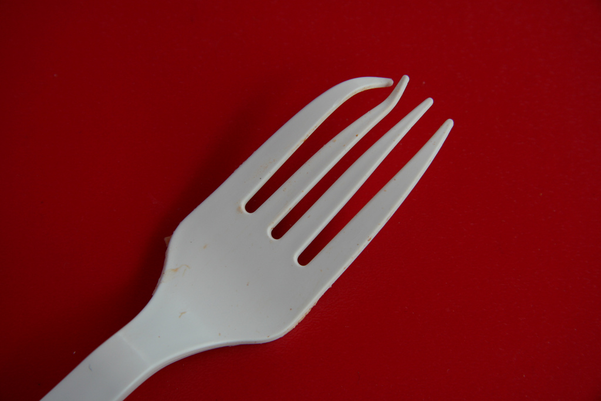
Soft Fork
Some old transactions become invalid
No invalid transactions become valid
Miner-activated Fork:
Majority miners upgrade
User-activated Fork:
Majority full nodes upgrade

Slide 66
Example: Pay-to-Script-Hash
Before: op code pays if …
“correct hash value preimage pushed on stack”
After: op code pays if …
“script pushed on stack evaluates to true”

Slide 67
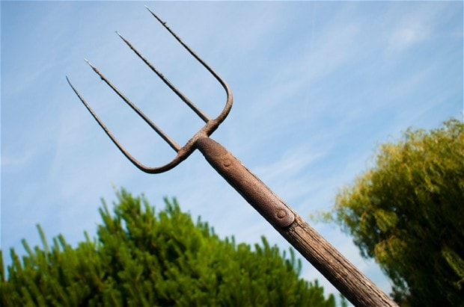
Hard Fork
Previously invalid transactions become valid
Changing reward, block size, etc.
Example:
Bitcoin vs Bitcoin Cash blocksize change
Hard to do

Slide 68
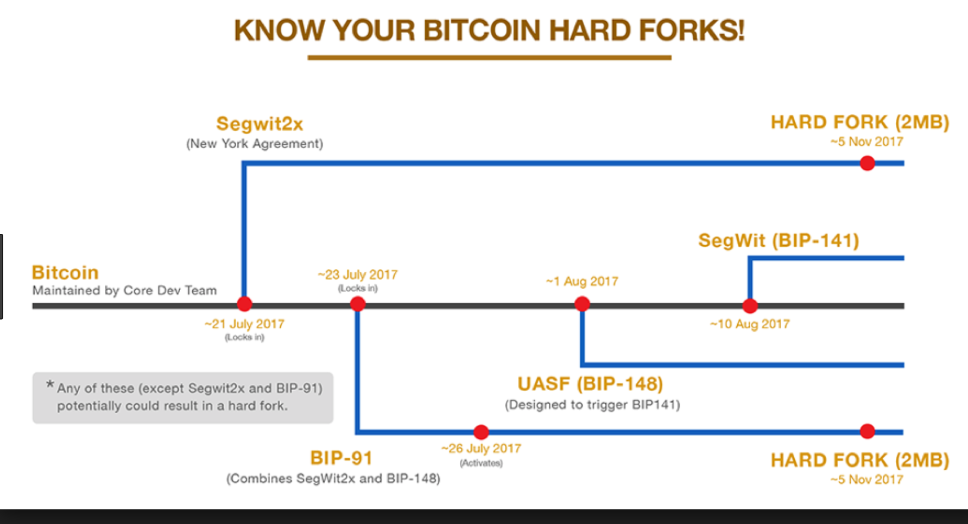
Bitcoin is bad at Governance

Slide 69
Bitcoin Long Term?

Slide 70

Game Theory
Nakamoto claims: Bitcoin is stable as long as miners follow own self-interest.
Is compliance a Nash equilibrium?
If so, do other equilibria exist?
Can non-compliant strategies dominate compliance?
Selfish Mining?

Slide 71
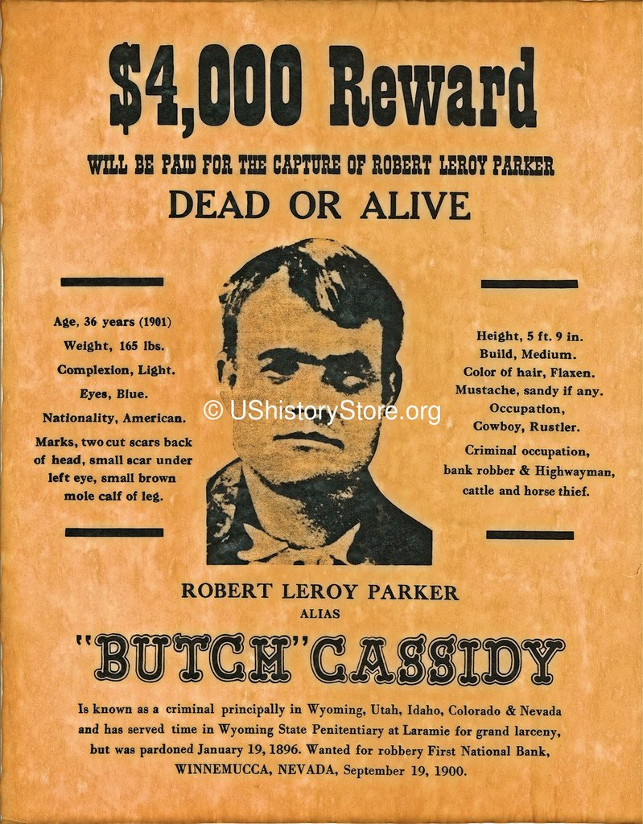
Stability when rewards decline?
Models assume constant coinbase reward
Effects of declining rewards? No rewards?
Model real-world vs BTC profits?
Liquidity & exchange rates?
Sunk costs (ASICS)?

Slide 72
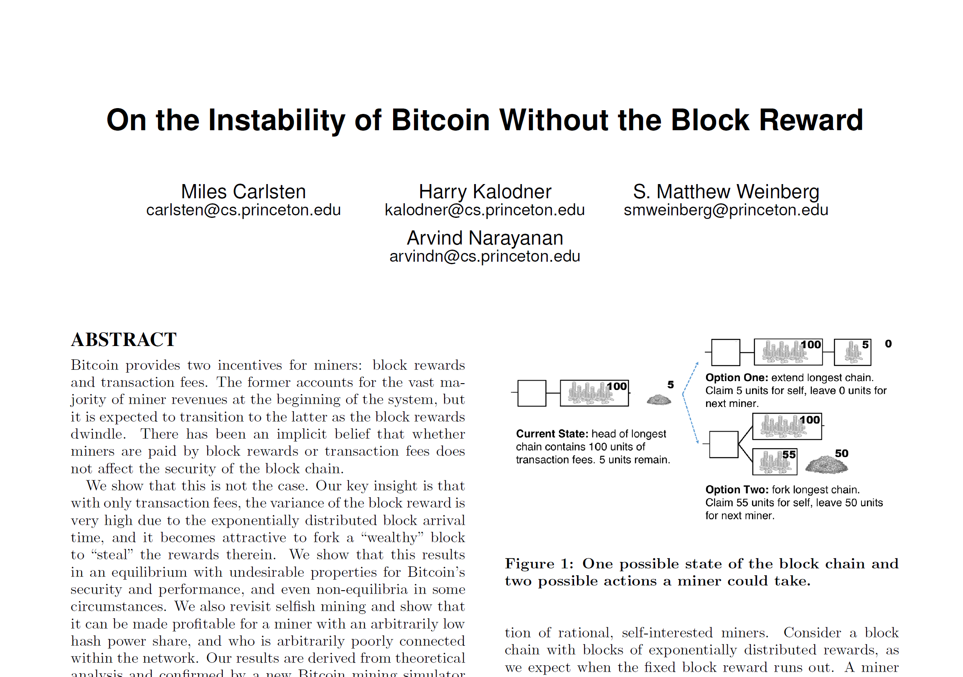
Stability?
In a future with no block rewards …
Only transaction fees…
May be more effective to steal “whale” transactions …
Than to build on other blocks
Existential threat?

Slide 73

Magic Numbers
Inter-block time & difficulty adjustment window
Limits on block & transaction size
(fighting words)
Dogecoin: harmonically-diminishing inflation
Monetary Policy: deflationary,
hoarding not spending
Freicoin: constant inflation
Choices poorly understood

Slide 74
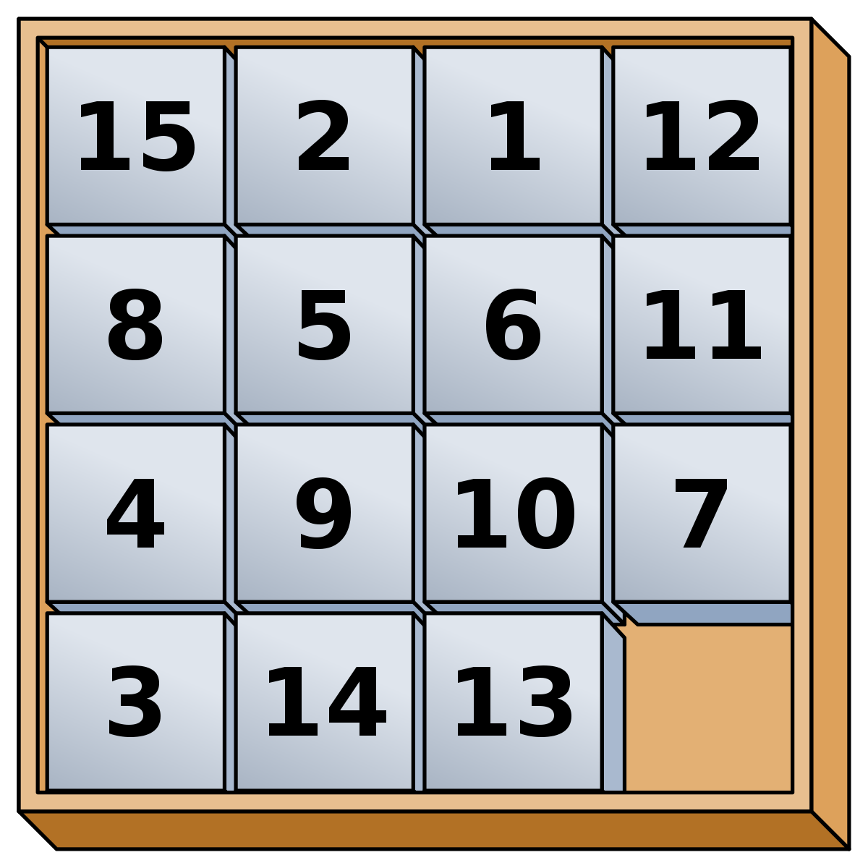
Alternative Computatonal Puzzles
Once, BTC mining was done on laptops
Now, mostly done with ASICs
Alternative: “memory hard” puzzles
Mining now requires capitalization,
Deep pocksts

Slide 75
Smart Contracts

Slide 76
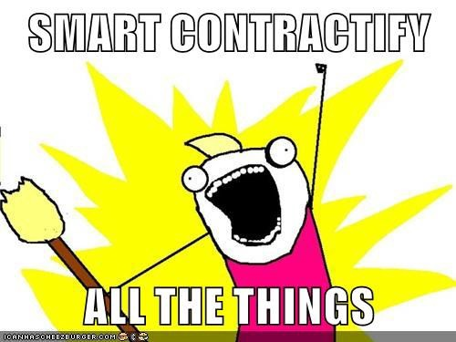

Slide 77
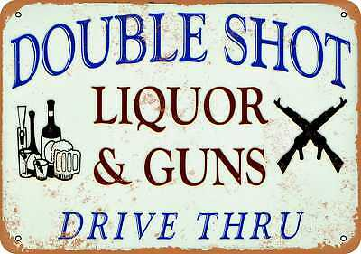
My own personal opinion about Solidity

Slide 78

Functional Programming

Slide 79
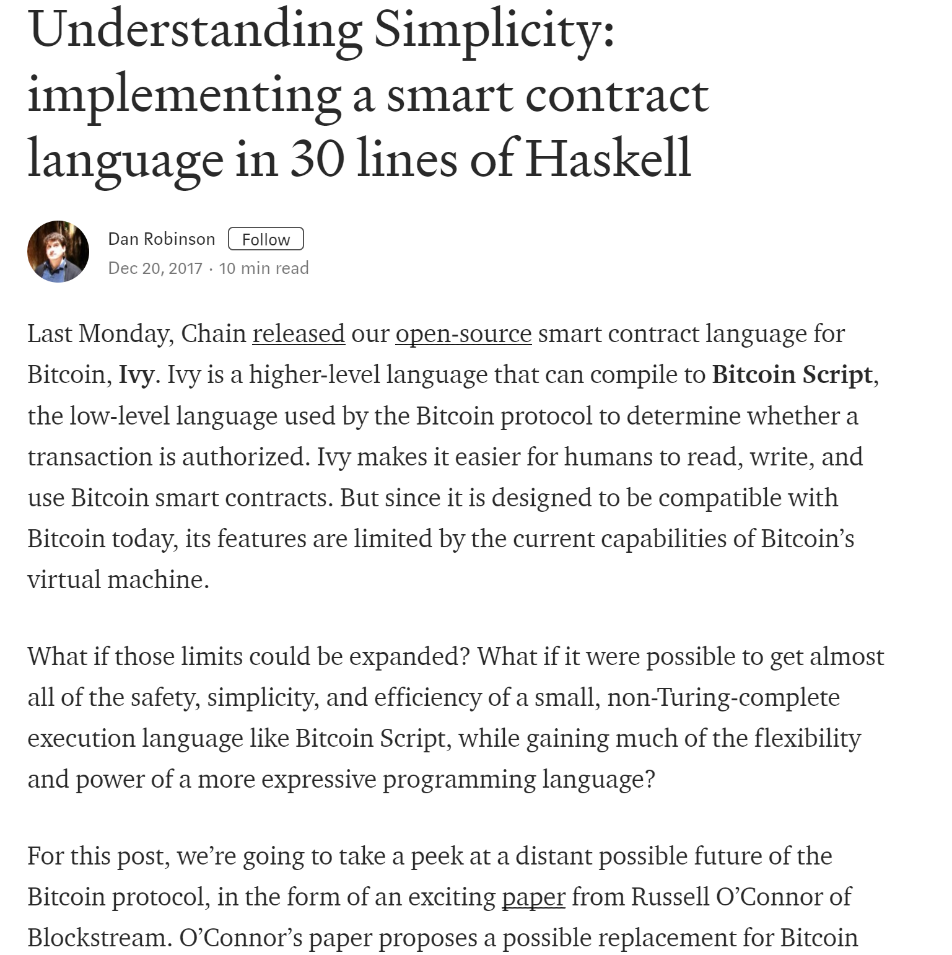
Functional language
Compiles to Bitcoin Script or EVM bytecode
“Turing Incomplete”
Static analysis, gas costs known, etc.
Mechanical Proof of Correctness

Slide 80
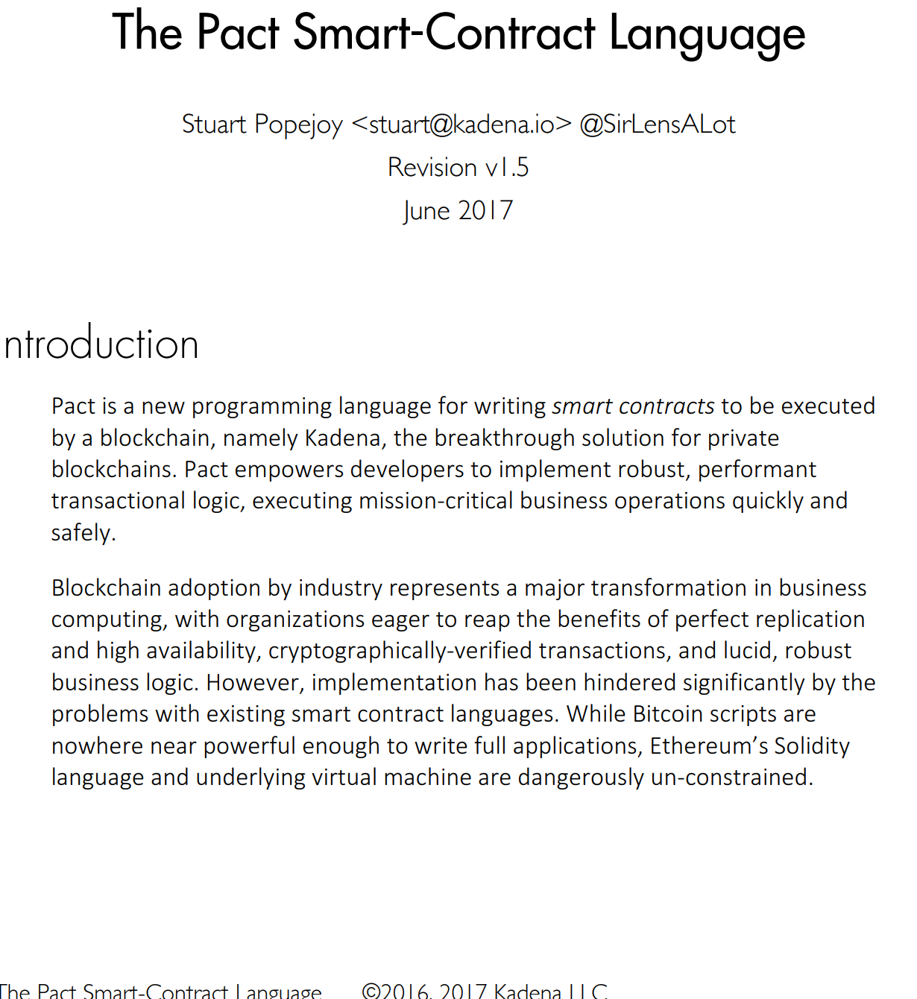
“Simply put, Turing-complete computation within a money-handling transactional environment is inappropriate and dangerous.”
More powerful than Simplicity, Bitcoin Script
Declaratve, immutable, “Business Rules”
Atomic transactions
Stored in Human-Readable form, not bytecode

Slide 81
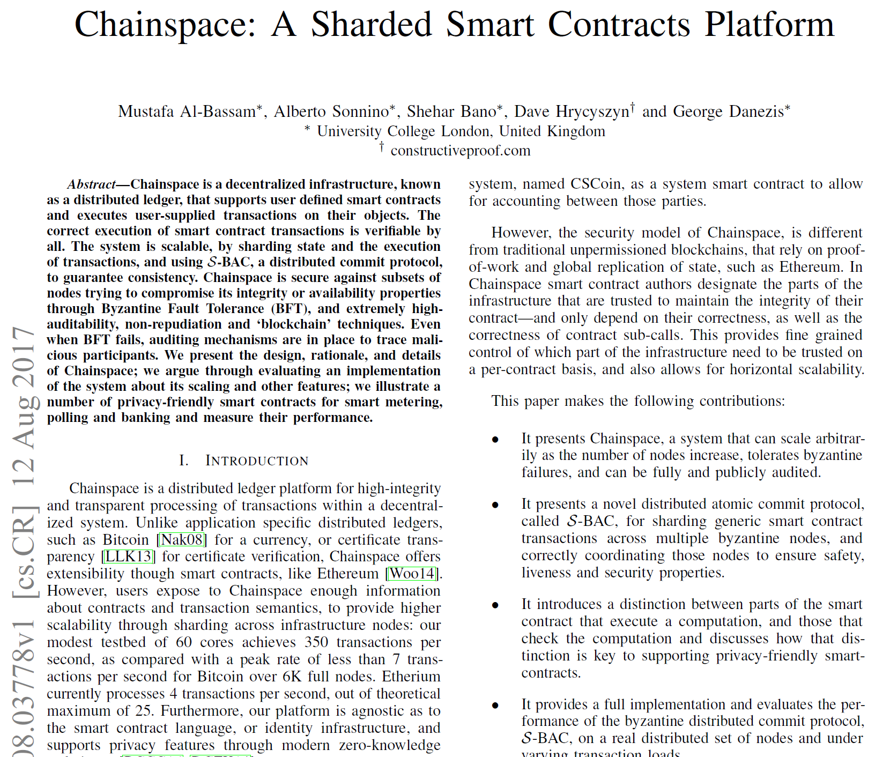
“distinction between parts of the smart
contract that execute a computation, and those that check the computation”
For privacy, some data encrypted
Contract has pure functional checker (returns Boolean)

Slide 82
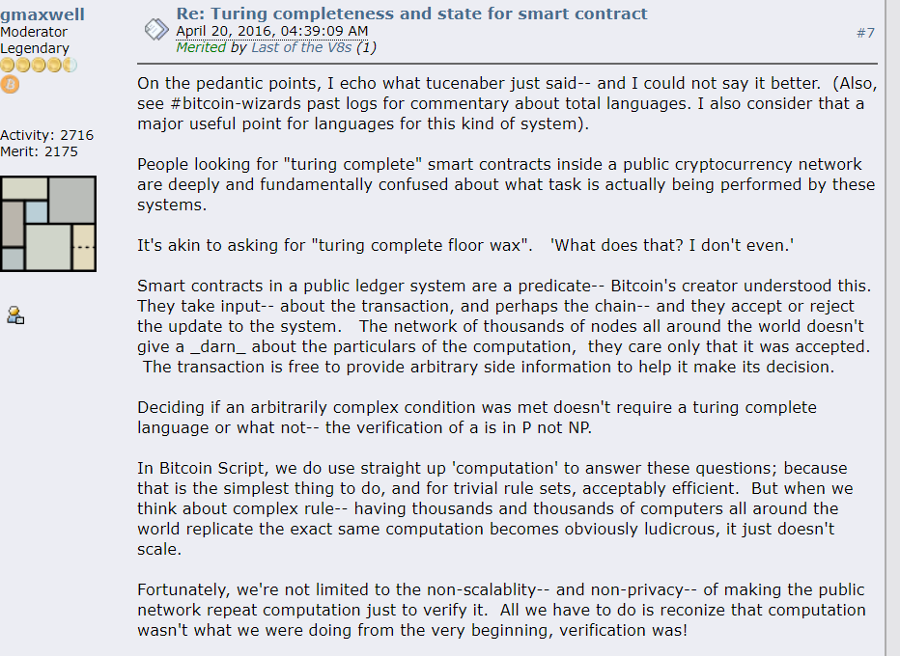
Greg Maxwell: blockchains should do verification, not computation
You don’t need Turing-complete programs to verify computations
Computation in NP? Verification in P!

Slide 83
"The program is big and I don't want to have to put it in the blockchain in advance."
Put only the hash of the program on the chain
Load it only when needed
Make the people who care pay for storage

Slide 84
"The program is big but we're only going to normally use one Nth of it-- the branches related to everything going right"
Decompose into Merkelized tree of ORs
Publish only active branches
Less space, more privacy

Slide 85
“The program is big, and there are fixed number of parties to the contract who will most likely cooperate”
Let the parties keep the contract
Publish on chain only if there’s a problem

Slide 86
“The program is big, and we don’t mind using economic incentives”
Alice: “I assert this contract accepts”, puts up bond
Bob: “I challenge Alice”, puts up bond
Alice must prove her claim
Winner keeps loser’s bond

Slide 87
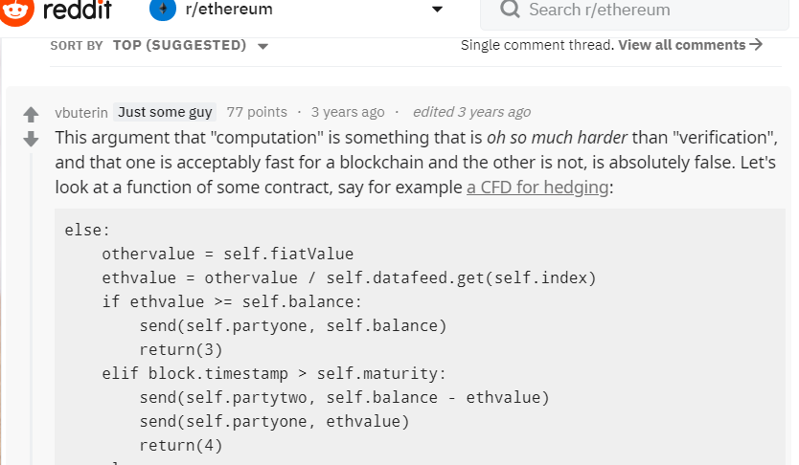
Rebuttal
V Buterin says:
In reality, computation dominated by signature validation
You know you want Turing-complete target VM for your compilers
Maxwell’s only use case: big programs
So what?

Slide 88
Conclusions

Slide 89

Follow the Money
Millions, billions in play
Every author, every opinion …
Who pays them?
What is their interest?
Not dishonest, but not disinterested.

Slide 90

Conclusions
Something called “Blockchain” will eat the world
Not just about cryptocurrency
We are doing it wrong
Lacking abstractions, formal methods, logics …
Time for action!

Slide 91
